Slide 1
Introduction

Slide 2
Steps in writing a computer program
problem formulation and specification
design of the solution
implementation
testing and documentation
evaluation of the solution

Slide 3
From Problems to Programs
half the battle is knowing what problem to solve (initially most problems have no precise specification)
If we can formalized a problem (express the problem in terms of a formal model)
we can look for solutions in terms of a precise model
and determine whether a program already exist to solve that problem
if it does not exist we can discover what is known about the model and use the properties of the model to help construct a good solution

Slide 4
How do we look for solutions??
In the form of an algorithm
is a finite sequence of instructions
each of which has a clear meaning
and can be performed with a finite amount of effort
in a finite length of time
e.g x = y + z //repetition can exist
however, no matter what the input values may be an algorithm terminates after executing a finite number of instructions
Thus a program is an algorithm as long as it never enters an infinite loop on any input

Slide 5
Implications
“clear meaning” /relative
“finite amount of effort”
“finite amount of time”
“it is difficult to prove that on any input a sequence of instruction terminates”
pseudo-language to represent algorithms

Slide 6
An example
Problem specification:
Design a traffic light for a complicated intersection of roads
Create a program that takes as input a set of permitted turns at an intersection (straight is also a turn)
and partitions this set into a few groups as possible such that all turns in a group are simultaneously permissible without collisions
Associate a phase of the traffic light with each group in the partition
finding a partition with the smallest number of groups we can construct a traffic light with the smallest number of phases

Slide 7
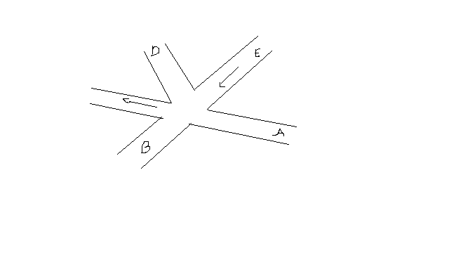
An intersection
13 turns, AB and EC can occur simultaneously
AD and EB cannot

Slide 8
Model
mathematical structure used is a graph
vertices represent turns whose edges connect pairs of vertices whose turns cannot be performed simultaneously
The graph can aid us in solving the traffic light design problem

Slide 9
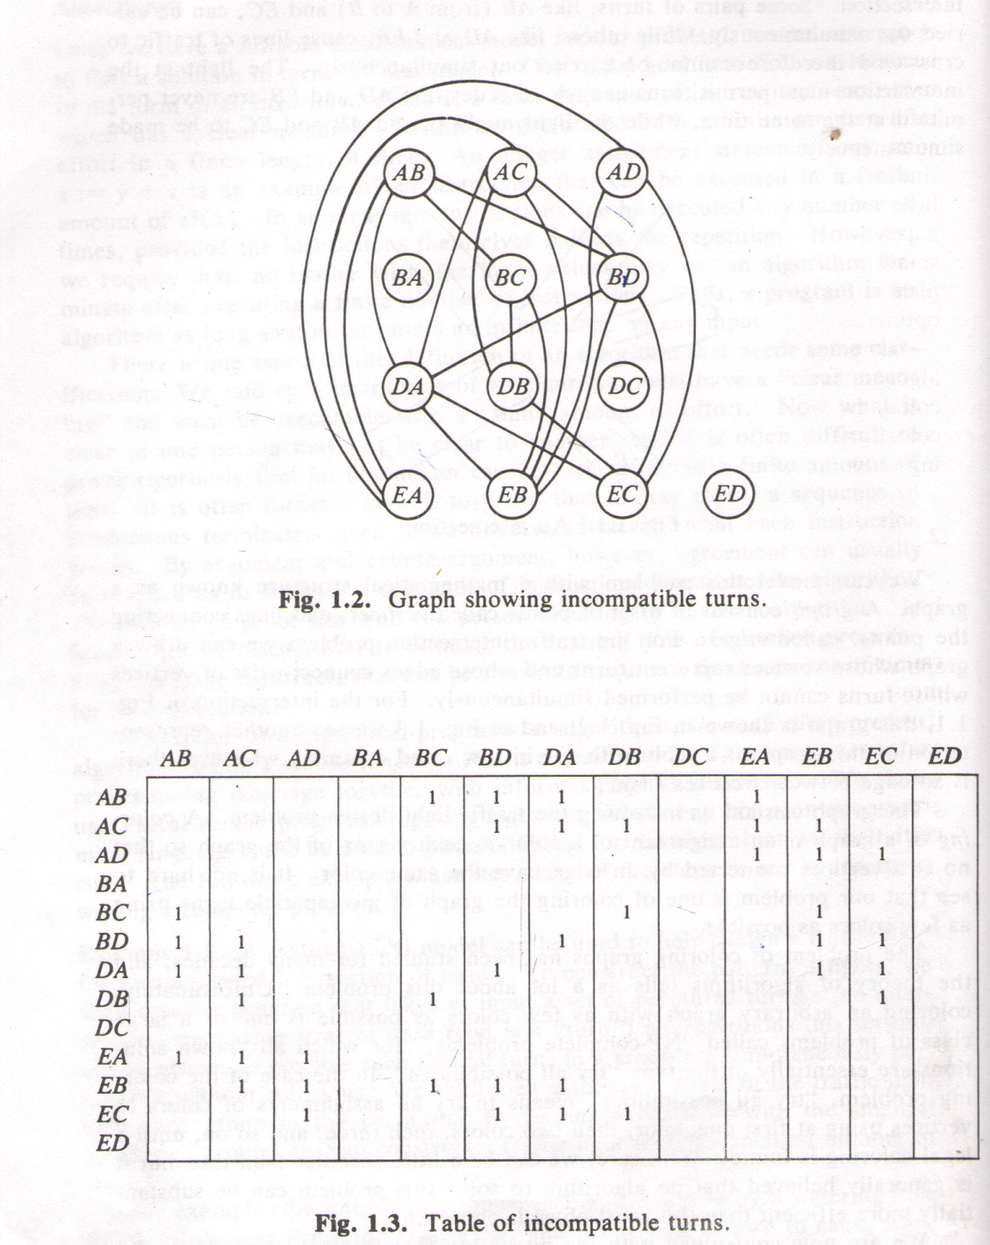
Graph

Slide 10
Coloring of graph
An assignment of color to each vertex of the graph so that no two vertices connected by an edge have the same color
NP-complete problems
3 approaches
optimal solution provided graph is small
look for additional information to help in skipping some possibilities
change the problem a little and look for a good if not optimal solution

Slide 11
Coloring of graph
An assignment of color to each vertex of the graph so that no two vertices connected by an edge have the same color
NP-complete problems
3 approaches
optimal solution provided graph is small
look for additional information to help in skipping some possibilities
change the problem a little and look for a good if not optimal solution

Slide 12
Coloring of graph
An algorithm that quickly produces good but not necessarily optimal solutions is called a heuristic
“greedy” algorithm is one such heuristic
select some uncolored vertex and color it with a new color
scan the list of uncolored vertices. For each uncolored vertex, determine whether it has an edge to any vertex already colored with the new color. if no, color the present vertex with the new color.

Slide 13
3
1
5
2
4

Slide 14
3
1
5
2
4

Slide 15
3
1
5
2
4

Slide 16
3
1
5
2
4

Slide 17
3
1
5
2
4

Slide 18
3
1
5
2
4

Slide 19
color | turns | extras
blue | AB,AC,AD,BA,DC,ED | __
red | BC,BD,EA | BA,DC,ED
green | DA,DB | AD,BA,DC,ED
yellow | EB,EC | BA,DC,EA,ED

Slide 20
Evaluation
In graph theory, a k-clique is a set of k vertices, every pair of which is connected by an edge.
Obviously k colors are needed to color a k-clique
AC, DA,BD,EB is a 4-clique
no traffic light can have fewer than 4 phases

Slide 21
For coloring vertices
Select some uncolored vertex and color it with the new color
Scan the list of uncolored vertices. for each uncolored vertex, determine whether it has an edge to any vertex already colored with the new color. If there is no edge, color the present vertex with the new color.

Slide 22
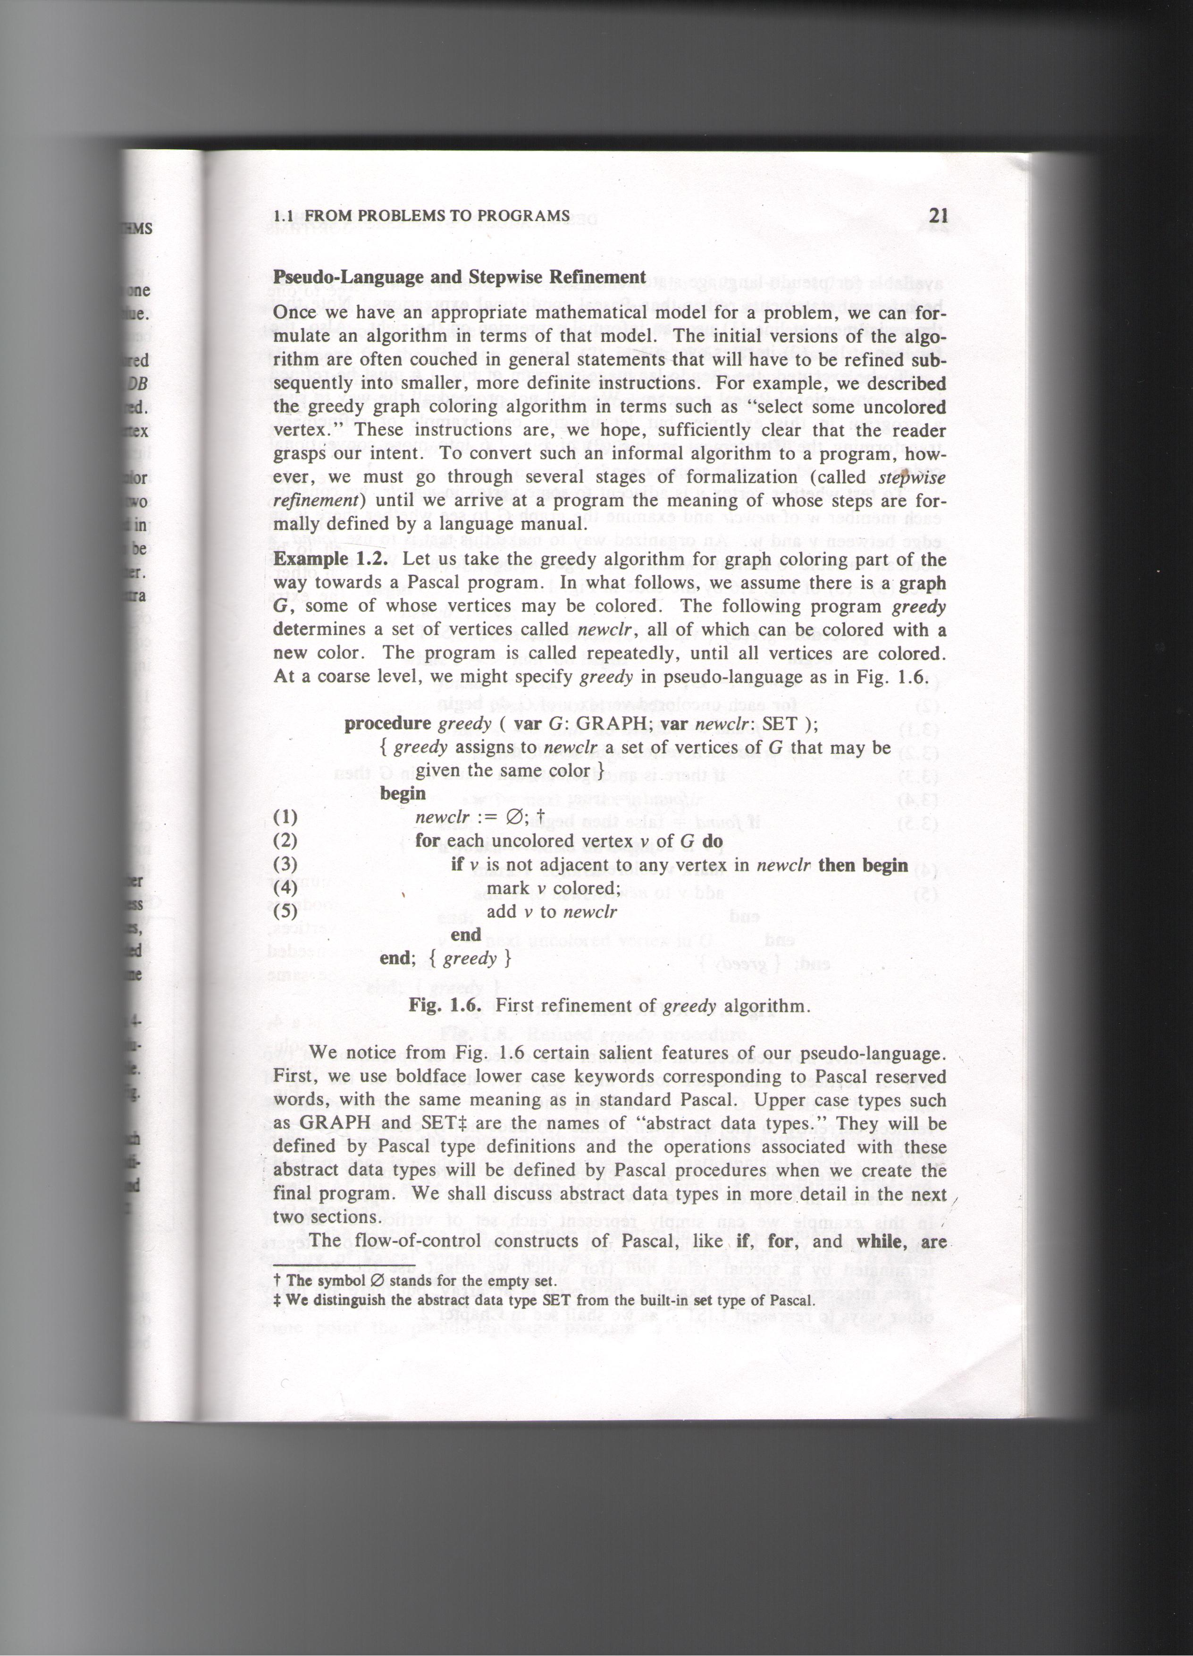
Pseudo-language

Slide 23
pseudo-language
boldface lower case keywords corresponding to Pascal
upper case such as GRAPH, SET are names of abstract data types
will be defined by Pascal type definitions
operations associated will be defined by Pascal procedures
line 3 is informal conditionals
line 1 is informal in the right
line 4 iterates over a set

Slide 24
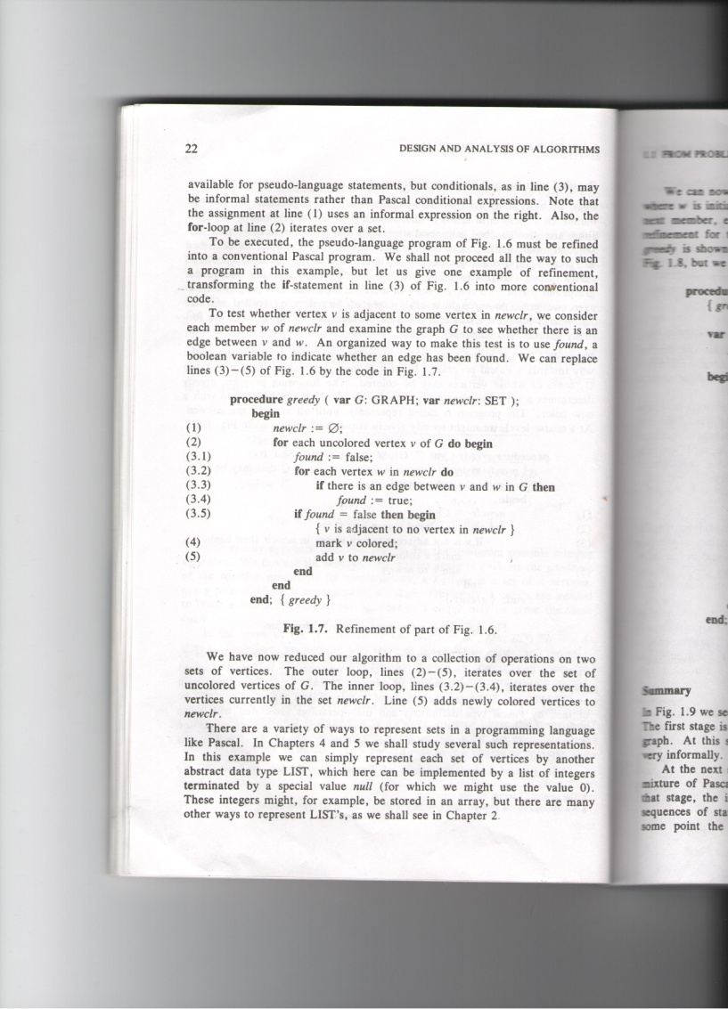
Step 1-refinement

Slide 25
Pseudo-language
use of boolean variable
2-5 iterates over a set of uncolored vertices of G
3.2- 3.4 iterates over the vertices currently in newclr
5 adds newly colored vertices to newclr

Slide 26
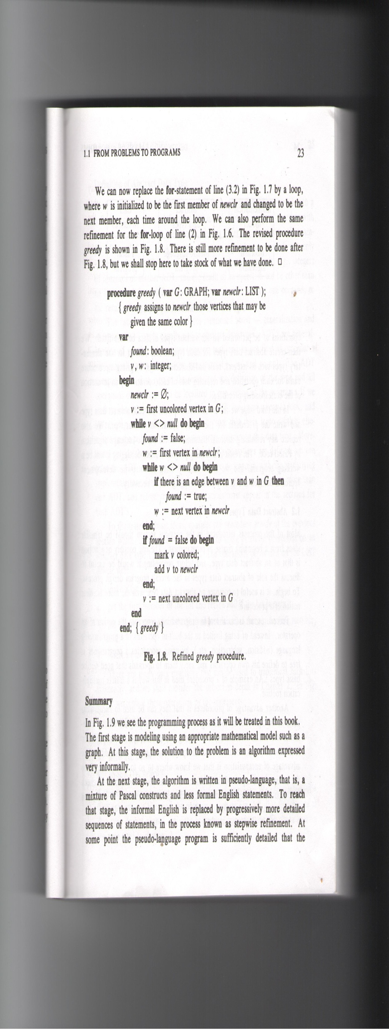
Step 2-refinement

Slide 27
Pseudo-language
using LIST –list of integers implemented by a list of integers terminated by a special value
3.2 where w is initialized to be the first member of newclr

Slide 28
Summary
1st stage
using an appropriate mathematical model such as a graph
solution is a an algorithm expressed informally
2nd stage
pseudo-language
3rd stage
choosing an implementation for each abstract data type and write the procedures for the various operations on that type
replace any informal language by Pascal code

